Slide 1
Machine Learning for Cybersecurity
Module 1 Live Session
Notes:
1hr long; ~10 min intro

Slide 2
Live Session Structure
First section (7:10 – 8:05 p.m.) 55 mins
Concept review (15 mins)
Brief overview of the case study (5 mins)
Lab session 1: Breakout rooms (25 mins)
Discussion and feedback (10 mins)
Break (8:05 – 8:10 p.m.) 5 mins
Second section (8:10 – 9:00 p.m.) 50 mins
Brief overview of the second case study (5 mins)
Lab session 2 – Breakout rooms (30 mins)
Discussion and feedback (15 mins)

Slide 3
Overview & Objectives
Concepts
Understand basic machine learning concepts
Describe the statistical learning framework
Identify biases and variances for empirical risk minimization
Differentiate discriminative and generative modeling
Basic supervised learning models:
Apply supervised models (LR, GNB, and Neural Networks) for classification
Experiment with and analyze these models via a Case Study (spam filtering)
Basic unsupervised learning models:
Apply generative models (GNB, LDA) for anomaly detection
Experiment with and analyze these models via a Case Study (detection of attacks)
Notes:
Gaussian Naïve Bayes, Linear discriminant analysis

Slide 4
Adversaries
Ethics
Attacker’s goals
Attacker’s capabilities
Robustness of model/feature
Privacy
Fairness
Transparency
Modules 2 – 4
Module 4
Module 2
Module 1
Identify Goals & Collect Data
Data Representation
Modeling
Deployment
Pinpoint needs
Data acquisition
Data labeling
Data exploration
Data cleaning
Missing data
Feature selection
Consider fairness
Efficiency
Accuracy
Interpretability
Adversarial resistance
Performance
Evasion and attacks
Model drift
Impact on stakeholders
Module 3
Notes:
In this module, we will focus on the modeling aspect of ML for cybersecurity. Particularly, we will assume that the learning task, including the learning objective and the training data are given, and we will dive into the statistical tools, and discuss the methodology of handling the data and achieving the given objectives.

Slide 5


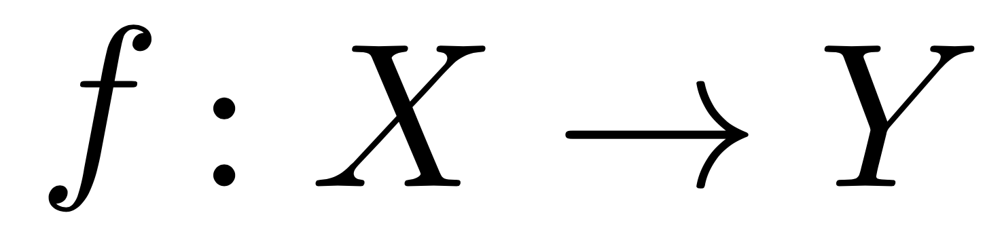
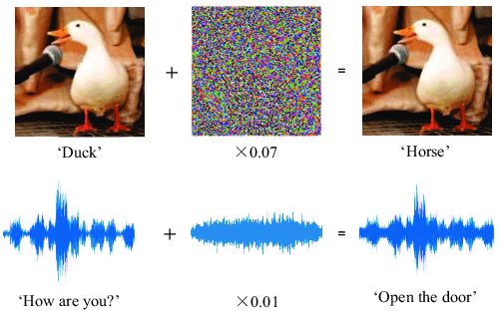
Machine Learning + Security

Slide 6
Supervised Learning (Module 1.2)
Discriminative models
E.g. Logistic regression
model P(y | x). Do not attempt to model P(x)
cannot detect outliers (property of P(x))
are typically more robust, since accurately modeling x may be difficult
Generative models
E.g., Gaussian (Naïve) Bayes, LDA (introduced in Demo 2)
model joint distribution P(x, y)
can be more powerful (e.g. detect outliers) if model assumptions are met
are typically less robust against outliers
Notes:
We zoom into two typical classes of supervised classification models, namely generative models for classification.
As the name suggests, a generative model not only focuses on making classification predictions for any given data points, but also describes how data is generated, in terms of a probabilistic model.
We will discuss a few concrete generative classification models, starting from ones that make strong distributional assumptions of the data, namely the Naive Bayes model, and then look into techniques that lift those assumptions for more general generative classification tasks.
We would like to statistically model the data:
Quantify uncertainty
Express prior knowledge / assumptions about the data

Slide 7
Unsupervised Learning (Module 1.3)
Unsupervised ML models
Anomaly detection (network/host intrusion detection)
Unsupervised “classification”
Clustering and K-Means algorithm
Unsupervised “regression”
Dimensionality reduction and PCA

Slide 8
Representation Learning (Module 1.4)
“Deep” models as powerful tools for learning representations
Multi-layer perceptron (generic statistical multi-layer/“deep” models)
Convolutional neural networks (images)
Convenient when the training data is
High-dimensional: DL as dimensionality reduction tools
Structured: DL learns a compact numerical representation
Massive: DL requires a large volume of training set

Slide 9
Breakout Room Preparation
Demo and breakout rooms
Session 1: Comparison of supervised learning models for spam classification
Session 2: Probabilistic models; generative modeling for anomaly detection
Session structure
Breakout rooms by group of 3, each team member with a pre-assigned role (see details below)
3 main subtasks per session, with an optional coding exercise in the end.
Each group can choose to focus on one subtask, and work on the remaining offline.
If time permits, feel free to try out the demos in other subtasks / exercises.
Notes:
Yuxin, please include the guiding questions for the breakout rooms here

Slide 10
Breakout Room Groups
Group 1 | Group 2 | Group 3
Raihan Rahman Vikram Tegginamath Jean-Leah Njoroge | Juan Piacquadio Jay Lowe Daniel Dobrzynski | Dwight Hohnstein Daniel Harkness George Huan
Group 4 | Group 5 | Group 6
Ryan Schroeer Alex Jayakumar Jayaraj Jason Harper | Suman Duvvuru Gleneesha Williams David Franks | Jake Kaminoff Conrad Zadlo Joe Klemencic

Slide 11
Demo 1: Classification
Notes:
Objectives:
How to apply machine learning models in python such as multi-layer perceptron, logistic regression and Gaussian Naive Bayes?
How do different classification algorithms behave on different data distributions?
What are the design choices of classification models? When should we care about training efficiency, label complexity, and accuracy?
How to evaluate and visualize the outcome of classification models?

Slide 12
Main Room Discussion – Group Report
Task 1.1: Comparison of classification models: classification accuracy
Which model is more robust to noise?
Which model has higher capacity (i.e. has the best accuracy)?
Notes:
Logistic regression; Naïve Bayes; Dimensionality reduction; Clustering
Yuxin, please feel free to add any anticipated outcomes from the demos you might expect or include questions/additional reflections here.

Slide 13
Main Room Discussion – Group Report
Task 1.2: Comparison of classification models: time complexity and label complexity
Which model is the most costly to train?
Does one model behavior strictly better than another? If yes, under what criteria? If no, what’s your design choice?

Slide 14
Main Room Discussion – Group Report
Task 1.3: Cost-effective data acquisition: Uncertainty sampling for logistic regression
Justify the max-entropy and min-probability sampling strategy used in the code.
Any scenarios in the cybersecurity domain requiring budget-efficient learning?

Slide 15
Main Room Discussion – Group Report
Task 1.4 (coding, optional): Apply the model of your choice to a spam filtering task
Is there any dimensionality reduction technique you can recall from this course to help visualizing the dataset?
Report the classification accuracy on the test data (use train/test split of 80:20).

Slide 16
Break 5 minutes

Slide 17
Demo 2: Anomaly Detection
Notes:
Learning objectives
How to apply generative models in python such as Gaussian Naive Bayes for anomaly detection tasks?
What are the design choices of probabilistic models? When should we care about discriminative models? When should we use generative models?
What assumptions are made for different generative models, such as Gaussian Naive Bayes and Fisher's LDA?
How to evaluate and visualize the outcome of probabilistic models?

Slide 18
Main Room Discussion & Wrap Up
Task 2.1: Comparison of the decision boundaries between generative and discriminative models
When do GNB and Logistic Regression make the same prediction?
Does one model behavior strictly better than another? If yes, under what cost?
Notes:
Logistic regression; Naïve Bayes; Dimensionality reduction; Clustering
Yuxin, please feel free to add any anticipated outcomes from the demos you might expect or include questions/additional reflections here.

Slide 19
Main Room Discussion & Wrap Up
Task 2.2:: Understanding probabilistic models for dimensionality reduction
Under what scenarios does LDA make a good model for dimensionality reduction?
Is LDA strictly better than PCA, or vice versa?
Notes:
Logistic regression; Naïve Bayes; Dimensionality reduction; Clustering
Yuxin, please feel free to add any anticipated outcomes from the demos you might expect or include questions/additional reflections here.

Slide 20
Main Room Discussion & Wrap Up
Task 2.3: Generative modeling for anomaly detection
Why can generative models be used to detect outliers/anomalies?
Can you tell if Fisher's LDA is robust against violation of its modeling assumption (i.e. equal class probability and intra-class covariance)?
Any application scenarios in the security domain, where generative models could be a particularly good fit?
Notes:
Logistic regression; Naïve Bayes; Dimensionality reduction; Clustering
Yuxin, please feel free to add any anticipated outcomes from the demos you might expect or include questions/additional reflections here.

Slide 21
Main Room Discussion & Wrap Up
Task 2.4 (coding, optional): Generative modeling for network intrusion detection
Justify your choice of anomaly detection models
Report the detection precisian and recall on the test data.
Notes:
Logistic regression; Naïve Bayes; Dimensionality reduction; Clustering
Yuxin, please feel free to add any anticipated outcomes from the demos you might expect or include questions/additional reflections here.

Slide 22
Overview of Module 5: Capstone Project
Capstone project
Apply fundamental concepts in course to a real-world cybersecurity scenario
Develop a real/ hypothetical cybersecurity machine learning deployment case study
Office hours
Attend at least once office hour session to receive early feedback
Project submission / report
Presentation (in groups) in our final live session
Personalized feedback on your strategy provided during the live session.
Notes:
From Julia’s notes:
Learning Objectives
By the end of this project you will be able to:
Apply conceptual machine learning concepts learned during the course to cybersecurity threat or task.
Identify, scope, and design a cybersecurity machine learning use case that can be applied to real world deployments.
Project Ideas
Past Project Examples
Intrusion Detection Models Using Machine Learning
Use of Machine Learning for DDoS Classification
Traffic Classification Based on Machine Learning Methods
Android Malware Classification Using Network Traffic
Predict DNS Request/Response Using Logistic Regression

Slide 23
Upcoming events & reminders
ML for Cybersecurity Happy Hour will be on Thursday, April 1 at 6:00 p.m. CT
Office Hours with Yuxin Chen will be on Thursday, April 1 at 7:00 – 7:30 pm CT
Please contact the Teaching Assistant, Weijia He at hewj@uchicago.edu with any content-related questions.
Please contact Julie Hanlon at online@uchicago.edu with any Canvas or Zoom related questions.
Notes:
Valorie Nash to lead

Slide 24
Main Room Discussion – Group Report
Task 1.1: Comparison of classification models: classification accuracy
Which model is more robust to noise?
Which model has higher capacity (i.e. has the best accuracy)?
Task 1.2: Comparison of classification models: time complexity and label complexity
Which model is the most costly to train?
Does one model behavior strictly better than another? If yes, under what criteria? If no, what’s your design choice?
Task 1.3: Cost-effective data acquisition: Uncertainty sampling for logistic regression
Justify the max-entropy and min-probability sampling strategy used in the code.
Any scenarios in the cybersecurity domain requiring budget-efficient learning?
Task 1.4 (coding, optional): Apply the model of your choice to a spam filtering task
Is there any dimensionality reduction technique you can recall from this course to help visualizing the dataset?
Report the classification accuracy on the test data (use train/test split of 80:20).
Notes:
Logistic regression; Naïve Bayes; Dimensionality reduction; Clustering
Yuxin, please feel free to add any anticipated outcomes from the demos you might expect or include questions/additional reflections here.

Slide 25
Main Room Discussion & Wrap Up
Task 2.1: Comparison of the decision boundaries between generative and discriminative models
When do GNB and Logistic Regression make the same prediction?
Does one model behavior strictly better than another? If yes, under what cost?
Task 2.2:: Understanding probabilistic models for dimensionality reduction
Under what scenarios does LDA make a good model for dimensionality reduction?
Is LDA strictly better than PCA, or vice versa?
Task 2.3: Generative modeling for anomaly detection
Why can generative models be used to detect outliers/anomalies?
Can you tell if Fisher's LDA is robust against violation of its modeling assumption (i.e. equal class probability and intra-class covariance)?
Any application scenarios in the security domain, where generative models could be a particularly good fit?
Task 2.4 (coding, optional): Generative modeling for network intrusion detection
Notes:
Logistic regression; Naïve Bayes; Dimensionality reduction; Clustering
Yuxin, please feel free to add any anticipated outcomes from the demos you might expect or include questions/additional reflections here.

